Slide 1
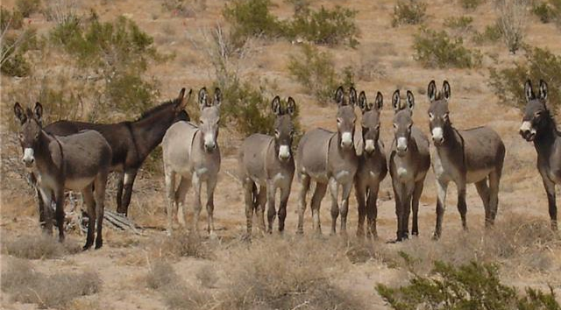

The People’s King #2 – 1 Samuel 10

Slide 2
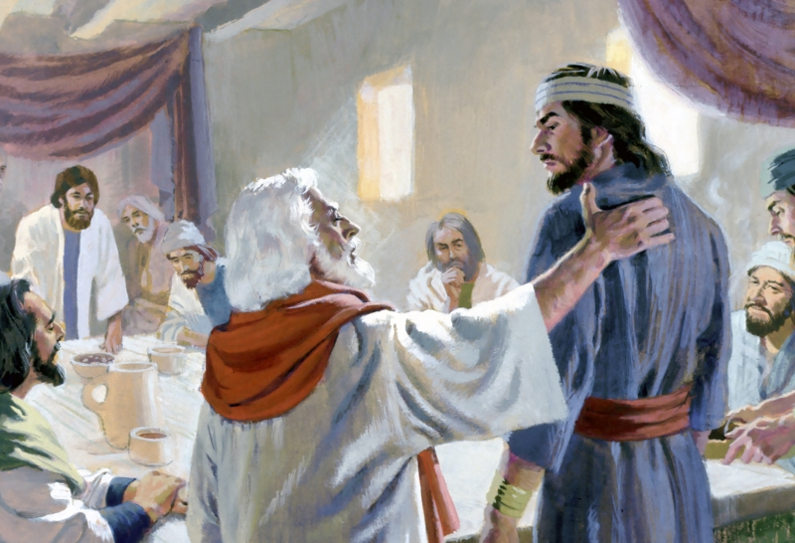

Slide 3
You can start good and end evil.
John 2:10 And saith unto him, Every man at the beginning doth set forth good wine; and when men have well drunk, then that which is worse: but thou hast kept the good wine until now.

Slide 4
Galatians 5:7-8 Ye did run well; who did hinder you that ye should not obey the truth? 8 This persuasion cometh not of him that calleth you.

Slide 5
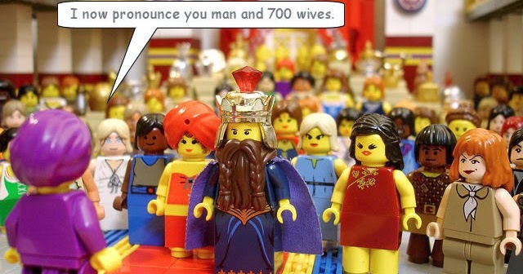
1 Kings 11:9 And the
LORD was angry with
Solomon, because
his heart was turned
from the LORD God
of Israel, which had
appeared unto him twice
1 Kings 11:2 Of the nations concerning which the LORD said unto the children of Israel, Ye shall not go in to them, neither shall they come in unto you: for surely they will turn away your heart after their gods: Solomon clave unto these in love.

Slide 6
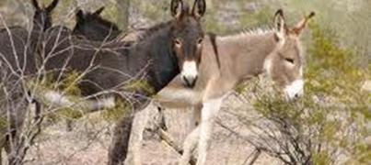
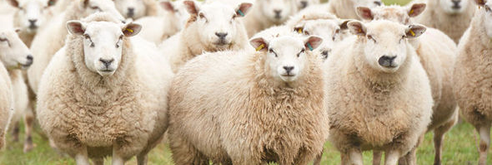
Saul is associated with the search for asses.
David is associated with protecting sheep.
Psalm 78:70-72 He chose David also his servant, and took him from the sheepfolds: 71 From following the ewes great with young he brought him to feed Jacob his people, and Israel his inheritance. 72 So he
fed them according to the
integrity of his heart; and
guided them by the
skilfulness of his hands.

Slide 7
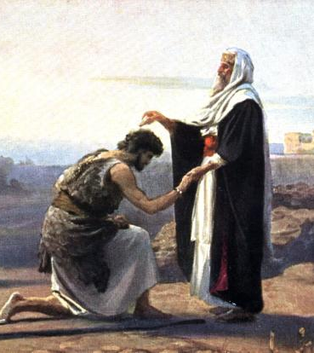
An anointing for his role.
No witnesses. This was revealed in secret. It was enough that God knew it.
KEY: What God is IN, you
do not have to force!
The anointing was first given for the priests.

Slide 8
Exodus 30:31 And thou shalt speak unto the children of Israel, saying, This shall be an holy anointing oil unto me throughout your generations.
1 John 2:27a “But the anointing which ye have received of him abideth in you”
Luke 4:18-19 The Spirit of the Lord is upon me, because he hath anointed me to preach the gospel to the poor; he hath sent me to heal the brokenhearted, to preach deliverance to the captives, and recovering of sight to the blind, to set at liberty them that are bruised, 19 To preach the acceptable year of the Lord.

Slide 9
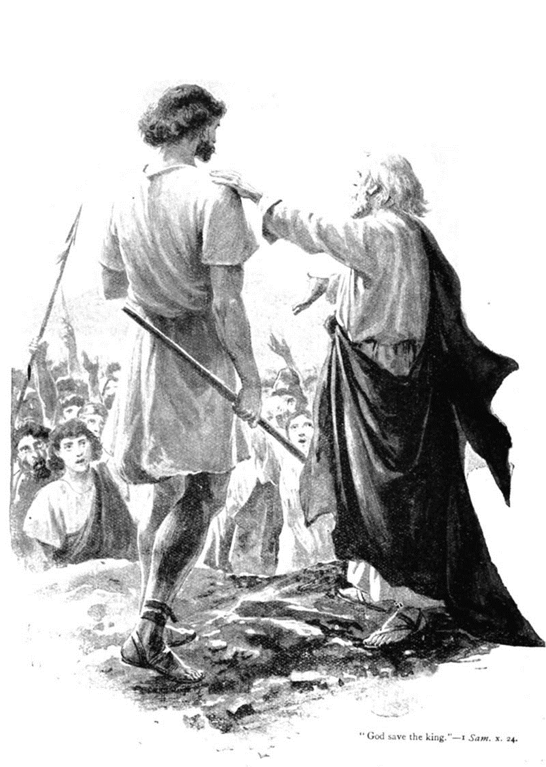
When Samuel showed Saul “the word of God,” Saul also saw ACCEPTANCE.
An appointing to leadership.
Growing leaders. There is no true leadership without locking in to the Word.
The people you lead are GOD’S people.
NEVER forget it.

Slide 10
1 Peter 5:2-4 Feed the flock of God which is among you, taking the oversight thereof, not by constraint, but willingly; not for filthy lucre, but of a ready mind; 3 Neither as being lords over God's heritage, but being ensamples to the flock. 4 And when the chief Shepherd shall appear, ye shall receive a crown of glory that fadeth not away.

Slide 11
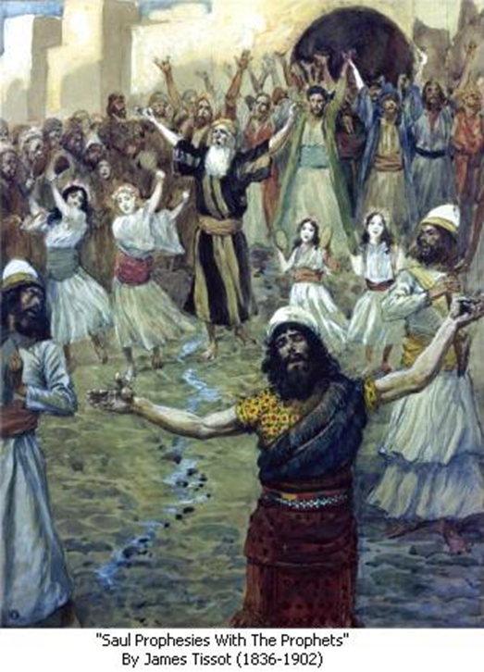
The evidence of accurate prophecies.
God’s proof for Saul’s new position.
No doubt: God knows where you’re at.
No fear: God knows what you need.
No worries: God will be with you.
No question: God will show you what to do!

Slide 12
Faith accepts the promises of God.
God gave Saul everything, including a new heart!
Saul didn’t keep and guard it!

Slide 13
Proverbs 4:20-27 20 My son, attend to my words; incline thine ear unto my sayings. 21 Let them not depart from thine eyes; keep them in the midst of thine heart. 22 For they are life unto those that find them, and health to all their flesh. 23 Keep thy heart with all diligence; for out of it are the issues of life. 24 Put away from thee a froward mouth, and perverse lips put far from thee. 25 Let thine eyes look right on, and let thine eyelids look straight before thee. 26 Ponder the path of thy feet, and let all thy ways be established. 27 Turn not to the right hand nor to the left: remove thy foot from evil.

Slide 14
1 Samuel 16:7 But the LORD said unto Samuel, Look not on his countenance, or on the height of his stature; because I have refused him: for the LORD seeth not as man seeth; for man looketh on the outward appearance, but the LORD looketh on the heart.
1 Samuel 16:14 But the Spirit of the LORD departed from Saul, and an evil spirit from the LORD troubled him.
Psalm 51:11 Cast me not away from thy presence; and take not thy holy spirit from me.

Slide 15
Ephesians 4:30 30 And grieve not the holy Spirit of God, whereby ye are sealed unto the day of redemption.

Slide 16

The proof that God keeps all His promises.
The proverb of Saul’s position.
It’s God that enables worship and the ministry of the Word.
Principle: What is in you is supposed to come out of you!

Slide 17
Romans 8:28 And we know that all things work together for good to them that love God, to them who are the called according to his purpose.

Slide 18
The People’s King #2 – 1 Samuel 10

